Slide 1
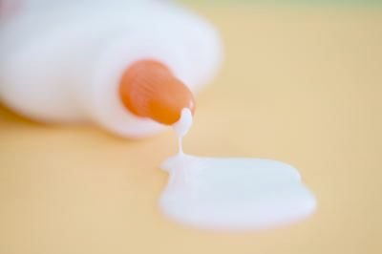
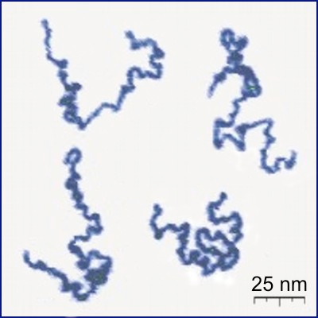
Polymers:
Long molecules made from many repeating parts (like a necklace)
Electron Microscope photo

Slide 2
Cross-linking Polymers
Crosslinker- Boric Acid

Slide 3
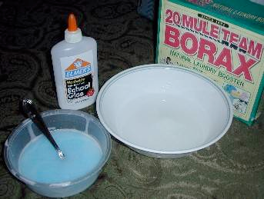
Slime:
a crosslinked polymer

Slide 4
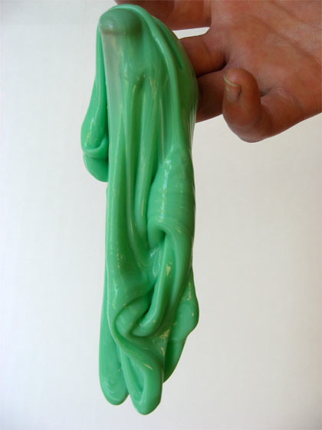
Slime

Slide 5
Directions:
20 mL water + 30 mL glue + 30 mL boric acid =
bouncy
25 mL water + 30 mL glue + 30 mL boric acid =
stretchier
30 mL water + 30 mL glue + 30 mL boric acid =
stretchiest

